Slide 1
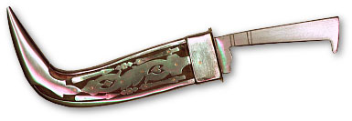
KIRPAN NOT DRAGGER

Slide 2
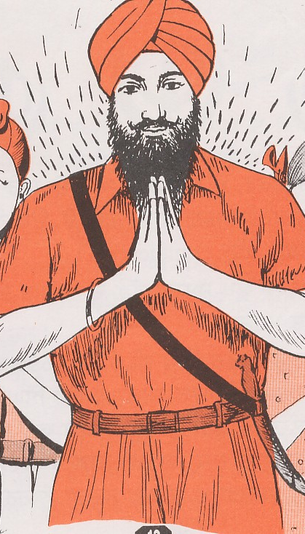
"Why are you carrying a dagger?"
Asking this question to a Sikh is wrong.
One will agree that we are not carrying our shirts and pants, but we are wearing them.
This (Kirpan in the sling), is an article of faith.
We wear it, we do not carry it.
Further, it is not a dagger, but a Kirpan.

Slide 3
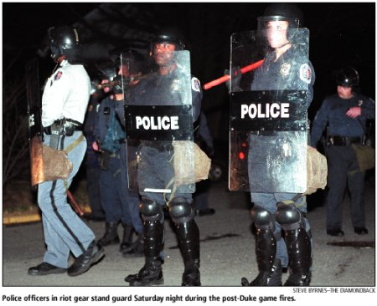
We know that robbers carry daggers to kill and rob people.
However, the Sikhs wear Kirpans to protect people.
Wearing of the Kirpan by a Sikh, can be explained by an analogy to the wearing of a pistol by a police man.

Slide 4
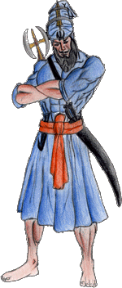
On the other hand, policemen use pistols not to kill people, but to protect them.
Therefore, the policemen are required to wear them to perform their duty and as a part of their uniform.
Sikhs are Sant-Sipahis (holy policemen), hence they are required to wear Kirpans as a part of their panj kakaar (5-K) uniform to be reminded of the responsibility of their faith to protect people
Spiritual Laws

Slide 5
"Why are you carrying a dagger?" This question sends a very wrong and derogatory message to a Sikh.
Surely, every police official will feel bad when he hears "He is carrying a pistol to kill people, whereas we pay him to protect people."

Slide 6
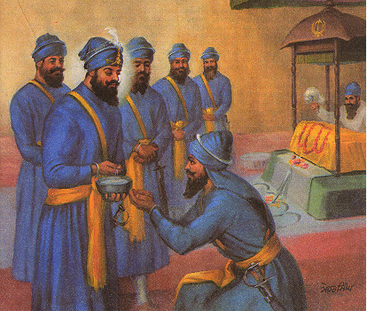
The Guru had a very solid reason to coin a new name, Kirpan, for this article of the Sikh faith;
Kirpan means a weapon for doing a favor to the people and protect their honor.
The name reflects the mission for which a Sikh wears it.
A Sikh is to publicly agree under oath before the Panj Pyaras for its genuine use before he is allowed to wear it.

Slide 7
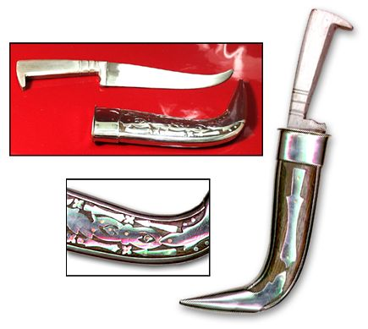
On the same analogy, the name of the pistol should be changed to protectil, when it is given to policemen for protecting and keeping peace.
This new name will also reveal the mission of the police.
It will provide them the psychology of service and motivate them for the right use of the equipment.
"Now, one know that a Sikh does not carry a dagger (weapon), but he wears a Kirpan."

